Slide 1
Social Studies Week 4
6th Grade

Slide 2
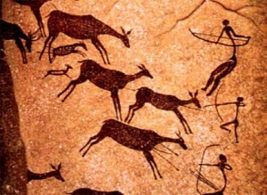
P. 15 Bell Ringer
Copy these questions down
What creatures/objects are represented in this cave drawing?
2. What do you think this drawing was made with?
3. What could you infer about early humans?

Slide 3
The Earliest Humans and the Stone Age
While you’re reading, mark !? * symbols
Highlight with colors (yellow & Green)

Slide 4
Archeology and Important Findings (p.16)
Code the article with ! (things that surprise you), ? (things that are confusing), and * (things that are important)
Highlight the “Power Words” yellow
Descriptions of “Power Words” must be highlighted green.

Slide 5
P. 17
Summarize the article “Archeology and Important Findings”
Summaries involve who, what, when, where, why

Slide 6
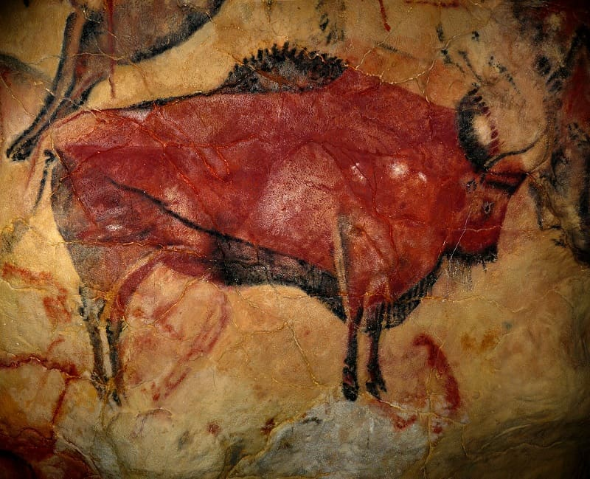
P. 15 Bell Ringer
Copy these questions down
What creatures/objects are represented in this cave drawing?
2. What do you think this drawing was made with?
3. How old do you think this is?

Slide 7
P. 15 Bell Ringer
Copy these questions down
Handprints bison and horses
2. This drawing is made with ochre and charcoal
3. This drawing is 35,600 years old (found in modern day Spain).

Slide 8
P. 15 Bell Ringer
The Altamira Cave
http://www.oldest.org/artliterature/cave-paintings/
Was discovered by Marcelino Sanz de Sautuola in Northern Spain. Discovered within the 19th century, the Altamira Cave was the original cave where prehistoric paintings were found. The paintings were of such a high quality that scientific society thought it was fake! At that time, most people didn’t think prehistoric humans had the intellectual ability to create something like this. But they could!

Slide 9
Welcome to Altamira
https://www.bing.com/videos/search?q=the+altamira+cave&&view=detail&mid=7140BC5303D3BFA4E4517140BC5303D3BFA4E451&&FORM=VRDGAR

Slide 10
Turn to Page 7
Start Defining Your Power Words

