Slide 1
Week 4
6th Grade Language Arts

Slide 2
Classroom Leaders 2nd
Pencil Person(make sure the correct date is written on the board) Angel
DJ (can create a clean weekly play list for us to listen to by tomorrow)
Montrease, Brook, Summer, Corey
Electrician (turns lights on and off) Julian & Destiny
Teachers’ assistants (pass out materials & pick them up & run errands) Zoe, Triniti, Morgan, Isabella
Liveschool point taker Maddy, Morgan, Maxwell
Botanist (makes sure Ms. Kate doesn’t kill her cactus) Knox, Eayn
Team-Point Taker Alon, Duke, Grayson

Slide 3
Classroom Leaders 4th: DJs: Will, Briar, Ellis, Lukas, Chris, Spencer Electricians Ellis, Neviah, Spencer, Za’Corriun Teachers Assistants: Kaliyah Mishawn Liveschool Point-taker: Brayden, Jae’Suan Botanist: Ellis Neviah Team Point-Taker: Will & Laura & ZaCorriun, CJ

Slide 4
New Seats 2nd
GROUP 1: Angel, Summer, Giacamo, Quan’Tarius
GROUP 2: Miles, Dejuan, Isabella, Morgan
GROUP 3: Knox, Montrese, Sam, Kingston
GROUP 4: Victor, Julian, Zoe, Triniti
GROUP 5: Corey Trey
GROUP 6: Grayson, Maxwell, Yousif, Ed
LIBRARY LOUNGE: Alon, Brook, Destini, Eayn (can eat foods in class)

Slide 5
New Seats 4th
Winners for the week
GROUP 1: Jermiah, Cortesha, Jae’Suan, Laura
GROUP 2: Neviah, Lukas, Chris, Kaliya
GROUP 3: Brayden, CJ, Briar
GROUP 4: Will, Ellis, Noah
GROUP 5: Niko, Jacobi, Spencer
GROUP 6: LIB
RARY LOUNGE Mishawn, ZaCorrian

Slide 6
Team Points
GROUP 1
GROUP 2
GROUP 3
GROUP 4
GROUP 5
GROUP 6
LIBRARY LOUNGE

Slide 7
https://westend6thgrade.weebly.com/
New Homework – due Friday
ELA: Parts of Speech III https://www.noredink.com/learn/assignments/3347553

Slide 8
Materials Required
Pencil/pen
Homework Folder (with Pink bathroom passes inside)
Language Arts Folder/binder (with Writing Notebook inside)

Slide 9
Title Page 17 “Bell Ringers 8/26-8/30
Copy the following Questions

Slide 10
Monday: Today we will
Answer the Bell Ringer
Characterization Station
Conduct a character analysis with Bellanie and Princess/Ghost

Slide 11
p. 17 Bell Ringer Monday
The title of the text we are reading today is “The Most Important Night of Melanie’s Life”
What do you predict this story will be about? Explain your reasoning in complete sentences.

Slide 12
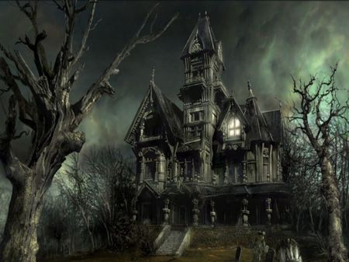
Characterization Lesson With Creepy Tales

Slide 13
“The Most Important Night of Melanie’s Life”
“Melanie turned her down flat. “It’s a matter of principle. If I start baby-sitting the boys, you and Dad will be going out every month or so. I wont be a teenager. I’ll be your slave. The twins are only nine, and the baby’s seven. They’re going to need sitting for years. I’ll be an old woman by then.”
Melanie knew she’d won when her mother sighed, ‘I sure miss Trish.” Up till last summer they could count on Trish from next door, but now she was away at college. ‘I guess we’ll have to find somebody else.”
Based on the excerpt above, what do you think the conflict is? Write it in your writing notebook! Justify your answer with evidence from the text.

Slide 14
“The Most Important Night of Melanie’s Life”
“A beautiful young girl came to visit this castle, and she started having these nightmares about a suit of armor. It was empty armor standing over in a corner. But in the dream, she’d seen the finger on one off the chain –mail gloves move. Her nightmare drew her nearer and nearer. Something urged her to release whoever was inside.
Her dream hand came out to lift the helmet’s visor. There within, staring back at her, were the empty eye sockets of an ancient skull. Black beetles glittered in the sockets, but all other life had long led. Her screams echoed down all the corridors you get in nightmares.”
Based on the excerpt above, what do you think the conflict is? Write it in your writing notebook! Justify your answer with evidence from the text.

Slide 15
“The Most Important Night of Melanie’s Life”
“I’m Ben.” He put out a big hand.
The stocking cap fell from Melanie’s grasp.
“Hey, Melanie, clear out,” Mike said. ‘We’re telling stories. No girls allowed’
“We’ve been having a great time,” Ben said, just to her.
“Yeah,” she said in a voice nobody had ever heard from her. “They’re nice little boys.”
She and Ben were shaking hands very slow.
Based on the excerpt above, what do you think the conflict is? Write it in your writing notebook! Justify your answer with evidence from the text.

Slide 16
“The Most Important Night of Melanie’s Life”
“Why not?” Melanie said. “Before my parents get back.” Then in her regular voice she said to the twins and Clem, “You creeps don’t even think about getting into trouble, okay? Like make my day, right?”
Ben reached down, swept up Melanie’s stocking cap, and handed it back to her. They turned very near each other, and walked out of the house without a backward glance.
Based on the excerpt above, what do you think the conflict is? Write it in your writing notebook! Justify your answer with evidence from the text.

Slide 17
“The Most Important Night of Melanie’s Life”
“Are you all right?” She gasped, trying to pull Clem closer. “What have you been doing all this time? We just got word from the Hutchinsons.”
Based on the excerpt above, what do you think the conflict is? Write it in your writing notebook! Justify your answer with evidence from the text.

Slide 18
Reading 1: Draw a girl outline on page 18
Side one: write down examples of direct characterization
Side two: Write down important actions and dialogue from this character
Write a one paragraph reflection on what you think happens to her in the end. What struggle does she face and how does/doesn’t she change?

Slide 19
Reading 1: Draw a boy outline on page 19
Side one: write down examples of direct characterization (when character is described directly)
Side two: Write down important actions and dialogue from this character
Write a one paragraph reflection on what you think happens to him in the end. What struggle does he face and how does/doesn’t he change?

Slide 20
Tuesday Today We Will
Bell Ringer
Character Notes
Compare and contrast ”Belanie” with the Lady/Ghost couple
Quickwrite: What types of archetypes are in “The Most Important Night in Melanie’s Life”

Slide 21
Bell Ringer Tuesday p. 17
You have one minute to write down as many details as you can about our story “The Most Important Night of Melanie’s Life”

Slide 22
Guided Notes P. 20
You only need to write down what is bold and underlined
TYPES OF CHARACTERS
STATIC CHARACTERS (ALSO CALLED “FLAT CHARACTERS”): CHARACTERS WHO DO NOT REALLY CHANGE THROUGHOUT A STORY.
DYNAMIC CHARACTERS (ALSO CALLED “ROUND CHARACTERS”): ARE CHANGED BY A STORY’S CONFLICT!

Slide 23
Reading 1: Draw a girl outline on page 18
Side one: write down examples of direct characterization
Side two: Write down important actions and dialogue from this character
Write a one paragraph reflection on what you think happens to her in the end. What struggle does she face and how does/doesn’t she change?

Slide 24
Reading 1: Draw a boy outline on page 19
Side one: write down examples of direct characterization (when character is described directly)
Side two: Write down important actions and dialogue from this character
Write a one paragraph reflection on what you think happens to him in the end. What struggle does he face and how does/doesn’t he change?

Slide 25
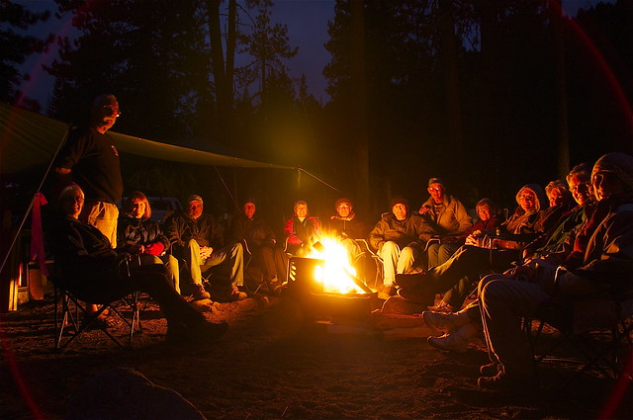
Bell Ringer Wednesday p. 17
What are different types of conflict in stories?

Slide 26
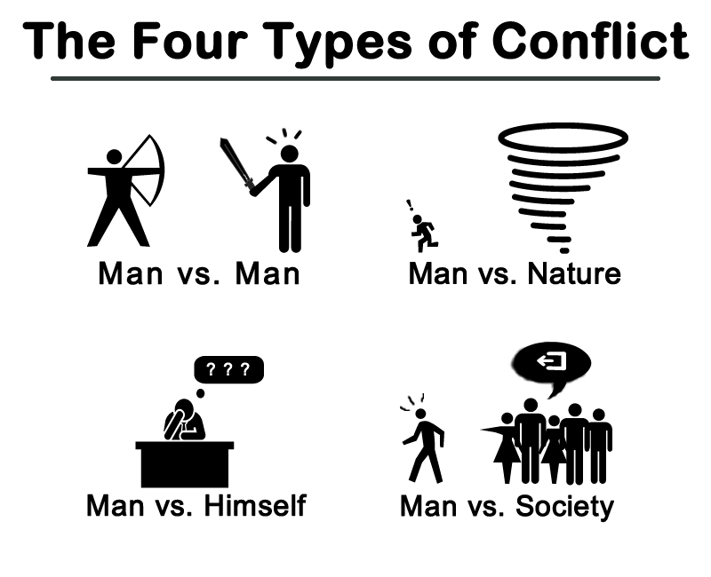
Bell Ringer Wednesday p. 17
I prefer
character vs. character
Character vs. nature
Character vs. self
Character vs. society
There is also character vs.
Technology, but wouldn’t that
Fall into being a product of society?

Slide 27
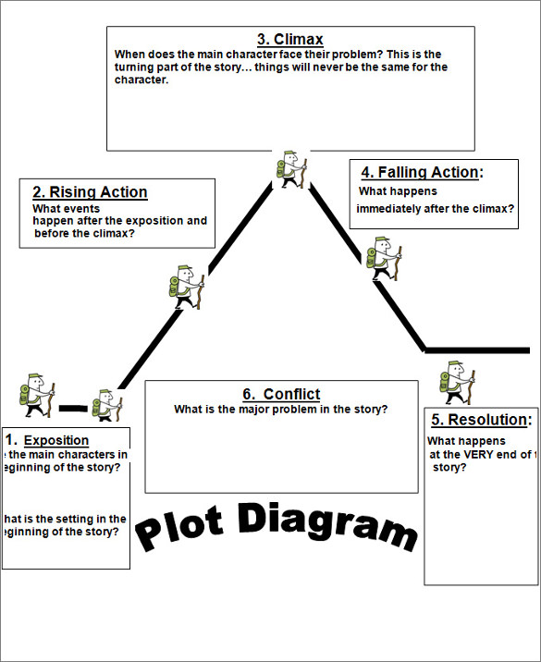
P. 20 Practice with Pixar
Draw this and diagram the plot
of Day and Night

Slide 28
P. 20 Practice with Pixar
Draw this and diagram the plot
of “For the Birds”

Slide 29
P. 21 Practice with Creepy Tales
Draw this and diagram the plot
Of “The Most Important Night of
Melanie’s Life”

