Slide 1
Week 4
6th Grade Language Arts

Slide 2
Classroom Leaders 5th *DJs: Braylin, Drew, Charlotte, Preston, Vivienne, Rachel, Stella,, Silas, Isaiah, Charley, Kelsey *Electricians: Aida, Satchel *Teachers Assistants: Amanda, Vivienne, Avery, Charley, Hudson Liveschool Point-taker: Madeline, Seamus, Kate, Isaiah, Josh, Charley, Kelsey, Jack Botanist: Sophie, Team Point-Taker: Lyla Pencil Person: Amanda

Slide 3
Team Points
GROUP 1
GROUP 2
GROUP 3
GROUP 4
GROUP 5
GROUP 6
LIBRARY LOUNGE

Slide 4
https://westend6thgrade.weebly.com/
New Homework – due Friday
Honors: Components of a Sentence https://www.noredink.com/learn/assignments/3347541
ELA: Parts of Speech III https://www.noredink.com/learn/assignments/3347553

Slide 5
Materials Required
Pencil/pen
Homework Folder (with Pink bathroom passes inside)
Language Arts Folder/binder (with Writing Notebook inside)

Slide 6
Title Page 17 “Bell Ringers 8/26-8/30
Copy the following Questions

Slide 7
Monday: Today we will
Answer the Bell Ringer
Jigsaw puzzle our story together
Conduct a character analysis with Bellanie and Princess/Ghost

Slide 8
p. 17 Bell Ringer Monday
The title of the text we are reading today is “The Most Important Night of Melanie’s Life”
What do you predict this story will be about? Explain your reasoning in complete sentences.

Slide 9
“The Most Important Night of Melanie’s Life”
“Melanie turned her down flat. “It’s a matter of principle. If I start baby-sitting the boys, you and Dad will be going out every month or so. I wont be a teenager. I’ll be your slave. The twins are only nine, and the baby’s seven. They’re going to need sitting for years. I’ll be an old woman by then.”
Melanie knew she’d won when her mother sighed, ‘I sure miss Trish.” Up till last summer they could count on Trish from next door, but now she was away at college. ‘I guess we’ll have to find somebody else.”
Based on the excerpt above, what do you think the conflict is? Write it in your writing notebook! Justify your answer with evidence from the text.

Slide 10
“The Most Important Night of Melanie’s Life”
“A beautiful young girl came to visit this castle, and she started having these nightmares about a suit of armor. It was empty armor standing over in a corner. But in the dream, she’d seen the finger on one off the chain –mail gloves move. Her nightmare drew her nearer and nearer. Something urged her to release whoever was inside.
Her dream hand came out to lift the helmet’s visor. There within, staring back at her, were the empty eye sockets of an ancient skull. Black beetles glittered in the sockets, but all other life had long led. Her screams echoed down all the corridors you get in nightmares.”
Based on the excerpt above, what do you think the conflict is? Write it in your writing notebook! Justify your answer with evidence from the text.

Slide 11
“The Most Important Night of Melanie’s Life”
“I’m Ben.” He put out a big hand.
The stocking cap fell from Melanie’s grasp.
“Hey, Melanie, clear out,” Mike said. ‘We’re telling stories. No girls allowed’
“We’ve been having a great time,” Ben said, just to her.
“Yeah,” she said in a voice nobody had ever heard from her. “They’re nice little boys.”
She and Ben were shaking hands very slow.
Based on the excerpt above, what do you think the conflict is? Write it in your writing notebook! Justify your answer with evidence from the text.

Slide 12
“The Most Important Night of Melanie’s Life”
“Why not?” Melanie said. “Before my parents get back.” Then in her regular voice she said to the twins and Clem, “You creeps don’t even think about getting into trouble, okay? Like make my day, right?”
Ben reached down, swept up Melanie’s stocking cap, and handed it back to her. They turned very near each other, and walked out of the house without a backward glance.
Based on the excerpt above, what do you think the conflict is? Write it in your writing notebook! Justify your answer with evidence from the text.

Slide 13
“The Most Important Night of Melanie’s Life”
“Are you all right?” She gasped, trying to pull Clem closer. “What have you been doing all this time? We just got word from the Hutchinsons.”
Based on the excerpt above, what do you think the conflict is? Write it in your writing notebook! Justify your answer with evidence from the text.

Slide 14
Share with your group
What was your excerpt about and how do you think the story fits together?
On page 16 of your notebook, Create a skit of how your group thinks the story goes
Must have a narrator (or 2) and 3 characters in your skit

Slide 15
Tuesday: Today we will
Answer the Bell Ringer
Finish skits
Conduct a character analysis with Bellanie and Princess/Ghost

Slide 16
P. 17 Bell Ringer Tuesday
Define direct and indirect characterization

Slide 17
Characterization Lesson With Creepy Tales

Slide 18
Reading 1: Draw a girl outline on page 18
Side one: write down examples of direct characterization
Side two: Write down important actions and dialogue from this character
Write a one paragraph reflection on what you think happens to her in the end. What struggle does she face and how does/doesn’t she change?

Slide 19
Reading 1: Draw a boy outline on page 19
Side one: write down examples of direct characterization
Side two: Write down important actions and dialogue from this character
Write a one paragraph reflection on what you think happens to him in the end. What struggle does he face and how does/doesn’t he change?

Slide 20
Wednesday Today We Will
Bell Ringer
Archetype Guided Notes
Compare and contrast ”Belanie” with the Lady/Ghost couple
Quickwrite: What types of archetypes are in “The Most Important Night in Melanie’s Life”

Slide 21
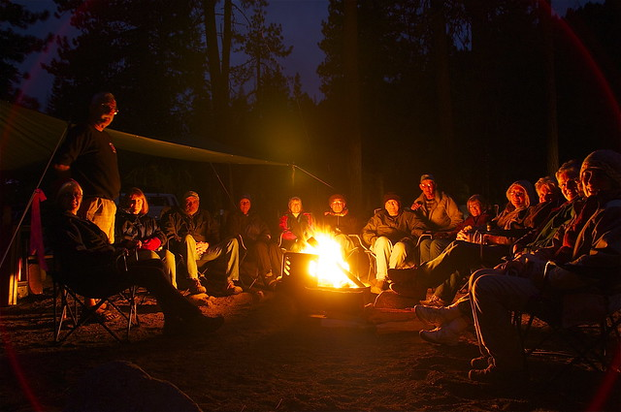
Bell Ringer Wednesday
What are the different parts of plot in a story?

Slide 22
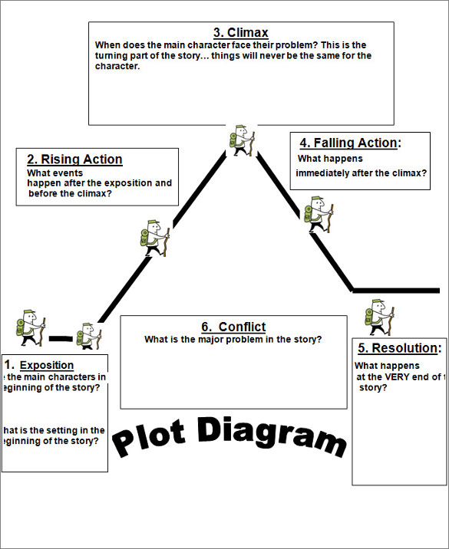
P. 20 Practice with Pixar
Draw this and diagram the plot
of Day and Night

Slide 23
Last 2 groups go for plays

Slide 24
Finish tracking characterization of Melanie

Slide 25
Anabelle Lee
Poetry Comparison
See document on blog

