Slide 1
Week 3
6th Grade Language Arts

Slide 2
Classroom Leaders 2nd
Pencil Person(make sure the correct date is written on the board) Angel
DJ (can create a clean weekly play list for us to listen to by tomorrow)
Montrease, Brook, Summer, Corey
Electrician (turns lights on and off) Julian & Destiny
Teachers’ assistants (pass out materials & pick them up & run errands) Zoe, Triniti, Morgan, Isabella
Liveschool point taker Maddy, Morgan, Maxwell
Botanist (makes sure Ms. Kate doesn’t kill her cactus) Knox, Eayn
Team-Point Taker Alon, Duke, Grayson

Slide 3
Classroom Leaders 4th: DJs: Will, Briar, Ellis, Lukas, Chris, Spencer Electricians Ellis, Neviah, Spencer, Za’Corriun Teachers Assistants: Kaliyah Mishawn Liveschool Point-taker: Brayden, Jae’Suan Botanist: Ellis Neviah Team Point-Taker: Will & Laura & ZaCorriun, CJ

Slide 4
Classroom Leaders 5th *DJs: Braylin, Drew, Charlotte, Preston, Vivienne, Rachel, Stella,, Silas, Isaiah, Charley, Kelsey *Electricians: Aida, Satchel *Teachers Assistants: Amanda, Vivienne, Avery, Charley, Hudson Liveschool Point-taker: Madeline, Seamus, Kate, Isaiah, Josh, Charley, Kelsey, Jack Botanist: Sophie, Team Point-Taker: Lyla Pencil Person: Amanda

Slide 5
New Seats 2nd
GROUP 1: Angel, Summer, Giacamo, Quan’Tarius
GROUP 2: Miles, Dejuan, Isabella, Morgan
GROUP 3: Knox, Montrese, Sam, Kingston
GROUP 4: Victor, Julian, Zoe, Triniti
GROUP 5: Corey Trey
GROUP 6: Grayson, Maxwell, Yousif, Ed
LIBRARY LOUNGE: Alon, Brook, Destini, Eayn (can eat foods in class)

Slide 6
New Seats 4th
Winners for the week
GROUP 1: Jermiah, Cortesha, Jae’Suan, Laura
GROUP 2: Neviah, Lukas, Chris, Kaliya
GROUP 3: Brayden, CJ, Briar
GROUP 4: Will, Ellis, Noah
GROUP 5: Niko, Jacobi, Spencer
GROUP 6: LIB
RARY LOUNGE Mishawn, ZaCorrian

Slide 7
Team Points
GROUP 1
GROUP 2
GROUP 3
GROUP 4
GROUP 5
GROUP 6
LIBRARY LOUNGE

Slide 8
https://westend6thgrade.weebly.com/
I am extending your homework due date to this Friday

Slide 9
Materials Required
Pencil/pen
Homework Folder (with Pink bathroom passes inside)
Language Arts Folder/binder (with Writing Notebook inside)

Slide 10
Title Page 12 “Bell Ringers 8/19-8/23
Copy the following Question

Slide 11
p. 12 Bell Ringer Monday
What is a symbol?

Slide 12
Symbolism
noun
1. the use of symbols to represent ideas or qualities.
2. symbolic meaning attributed to natural objects or facts.

Slide 13
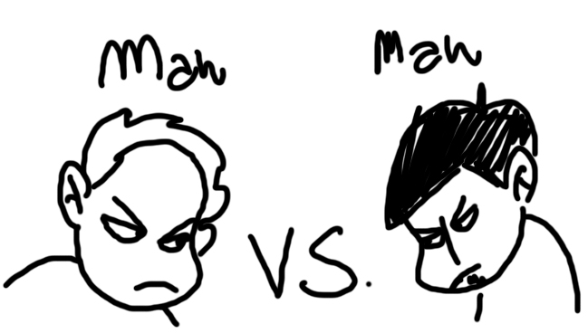
Bell Ringer Tuesday
What is a conflict

Slide 14
Bell Ringer Tuesday
A conflict is a struggle. What a character is trying to win against

Slide 15
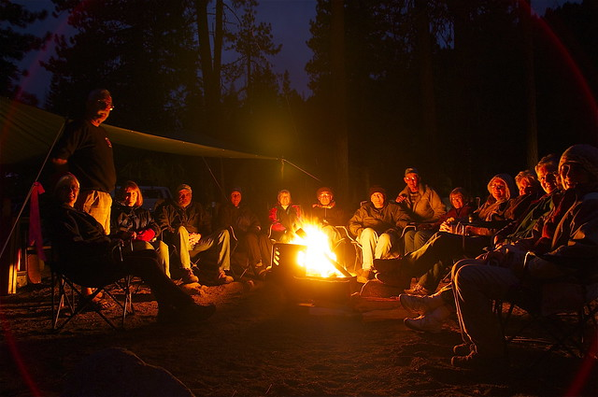
Bell Ringer Wednesday
What 5 things create a story?

Slide 16
Bell Ringer Wednesday
Plot, Character, Conflict and Theme!

Slide 17
Today we will
Review different types of conflict
Play “4 Corners” with conflict
Quickwrite: What did our discussion teach us about conflict?

Slide 18
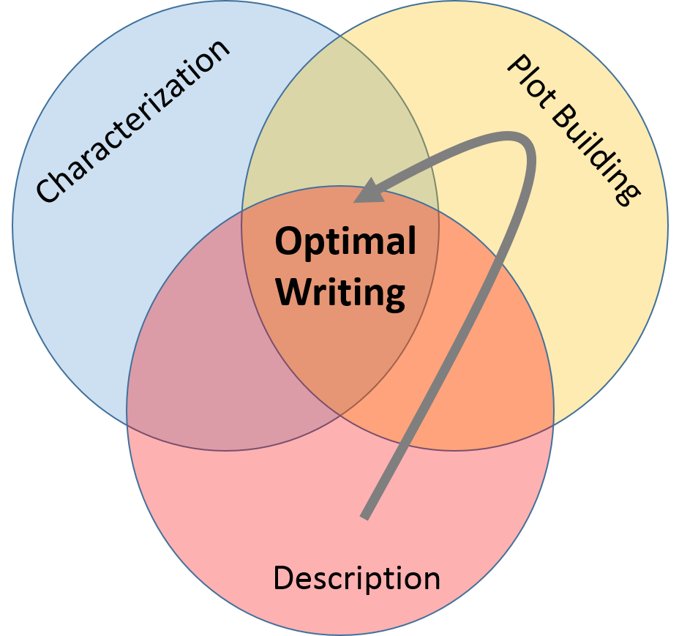
P. 12 Bell Ringer Thursday
What is a character? How do authors’ develop their personalities?

Slide 19
Bell Ringer Thursday
What is a character? How do authors develop their personalities?
Authors develop characters through direct description and indirect methods (character actions and statements). The indirect methods rely on reader inferencing abilities.
An inference is using hints to make a logical guess or assumption about character qualities.

Slide 20
Bell Ringer Thursday
Direct Characterization: The narrator describes the character with adjectives
EXAMPLE: Suzannah was a funny girl
INdirect Characterization: The narrator doesn’t really describe the character. But the reader can draw conclusions from actions and dialogue
EXAMPLE: Suzannah ran into the room and screamed “PINAPPLE,” the room burst into laughter.

Slide 21
P. 12 Bell Ringer Friday
What is a plot? What does it need to make it exciting?

Slide 22
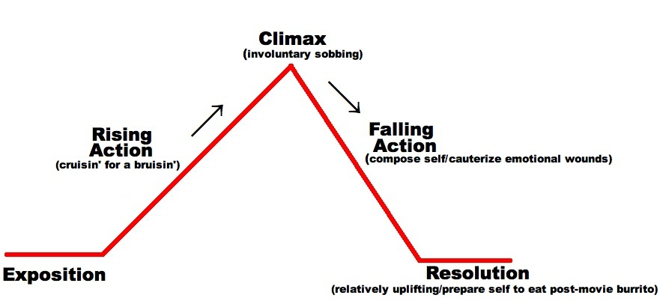
P. 12 Bell Ringer Friday
Plot parts and they need conflict

Slide 23
Today We Will
Bell Ringer
Characterization Activity
Quickwrite on “The Most Important night in your life”
Post-it share out
Start reading “Creepy Tales” and make predictions about the conflict

Slide 24
Colors
Color
Meaning
Maroon
Red
Orange
Gold or Yellow
Green
Blue
Purple
Black
Silver or White
Victorious in battle
Warrior, military strength
Ambition
Generosity and elevation of the mind
Hope, joy, love
Truth and loyalty
Royal majesty, justice
Constancy or grief
Peace and sincerity

Slide 27
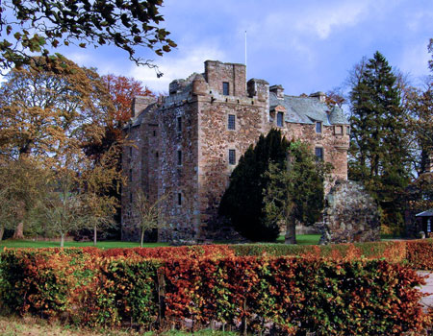

Slide 29
Plants
Symbol
Meaning
Acorn
Apple
Cherry Blossom
Daisy
Fern
Hibiscus
Holly
Lily
Shamrock
Antiquity and strength
Happiness, peace
Wealth and prosperity
Gentleness and innocence
Magic
Beauty
Truth, foresight
Purity
Perpetuity

Slide 31
Animals
Animal
Meaning
Bear
Butterfly
Cat
Dog
Dragon
Elephant
Fish
Lion
Swan
Cunning, ferocity
Psyche or soul
Liberty, vigilance
Courage and loyalty
Terror to all who beholders
Happiness, royalty, ambition
Generous mind
Dauntless courage
Grace and beauty

Slide 33
Miscellaneous
Object
Meaning
Anchor
Arrow
Caduceus
Clouds
Compass
Fire
Jewel
Sea shell
Hope, religious steadfastness
Readiness
Medicine
Mystery
Direction
Zealousness
Supremacy
Traveler

Slide 34
Create your own coat of arms
What to include?
What should I do afterward?
Use colors, creatures, plants, and other symbols that resonate with your personality
On the back of your coat of arms (or on a spare paper), explain how the creation symbolizes YOU
We will display in the room

Slide 35
“Conflict Guided Notes”
Put this title on page 14
We are about to take some guided notes
You only need to write down what is bold and underlined

Slide 36
1. What is Conflict?
The dramatic struggle between two forces in a story
Without conflict, there is no plot
Conflict is the heart of a story, the central organ keeping the story alive, the glue holding the details together, the thing that makes you care about a book

Slide 37
2. What are the types of conflict?
External Conflict (interpersonal) – happens outside the character
Human vs. Human – one character against another
Ex.: Tom in a sword fight with Bill; Mary writes mean notes to Sue
Human vs. Nature – the weather, illness, the outside world
Ex.: Tom gets stuck in the rain; Bills gets bitten by a rattlesnake; Mary trips on a stick; Sue is cornered by a bear

Slide 38
2. What are the types of conflict?
External Conflict (interpersonal) – happens outside the character
Human vs. Society – one character against a group of characters or against social norms or an organization like the government
Ex.: Tom gets made fun of by Bill, Mary, and Sue; Bill isn’t allowed to eat at a restaurant because he’s not wearing a shirt; Mary rallies against animal testing; Sue wears pants instead of a dress and is banned from attending the theater(it’s the 1850s).
Human vs. Technology – often in sci-fi where a character battles a machine; in present-day, a character might have trouble with a computer; in the past, a character might struggle with new technologies of the day (which might be antiquated technologies according to modern times)
Ex.: Tom is chased by a robot; Bill is trying to send an important email to Mary, but the internet connection is slow; Mary and Sue can’t go to town in their covered wagon (or BMW) because the wheel fell off (or went flat).

Slide 39
2. What are the types of conflict?
External Conflict (interpersonal) – happens outside the character
Human vs. the Supernatural – a character battles with a ghost or a deity
Tom and Bill are trapped in a haunted house and are scared by dead people; Mary and Sue are paralyzed by the goddess of water because they spilled the bucket pulling it out of the well (spilling the bucket could be considered human vs. technology (humans made wells to conquer water) and/or human vs. nature (water comes from the outside world); the being paralyzed by a goddess is the human vs. supernatural part))

Slide 40
2. What are the types of conflict?
External Conflict (interpersonal) – happens outside the character
Human vs. the Supernatural – a character battles with a ghost or a deity
Tom and Bill are trapped in a haunted house and are scared by dead people; Mary and Sue are paralyzed by the goddess of water because they spilled the bucket pulling it out of the well (spilling the bucket could be considered human vs. technology (humans made wells to conquer water) and/or human vs. nature (water comes from the outside world); the being paralyzed by a goddess is the human vs. supernatural part))

Slide 41
2. What are different types of conflict?
Internal Conflict (intrapersonal) – happens inside the character
Human vs. Self – a character battles his or her emotions, mind, or will
Tom is depressed; Bill is confused; Mary wants to steal lipstick but knows it’s not right; Sue doesn’t know what decision to make

Slide 42
3. Sometimes we get all the conflicts
In good literature, there is often a combination of conflicts.
A fight with a friend (external: human vs. human) causes regret (internal: human vs. self).
A kid gets bullied at school (external: human vs. society) and is afraid to walk in the hallways (internal: human vs. self).
Also note that sickness, though often felt inside the body, is considered external conflict because it qualifies as human vs. nature. Sickness (external: human vs. nature), though, may cause sadness (internal: human vs. self), so there still may be overlap.

Slide 43
4 Corners with Conflict
You have a problem
Use your notes to figure out what type of conflict your problem fits into!
Keep in mind, it is debatable, so make sure you are ready to argue your point

Slide 44
Expectations for the discussion
The more you participate, the more liveschool points you receive
It is a big group discussion, so only one person may talk at a time
If you do not follow the rules and play around, you will forfeit recess (play now, or play later?)

Slide 45
Page 15 Freewrite
Respond to the following prompt
What is one thing you learned through this discussion on conflict? What did you find confusing and why?

Slide 46
On page 15 Write this question and answer it.
What was the most important night in your life so far?
Describe sensory details (sights, sounds, smells) and why this night was so important?

Slide 47
“The Most Important Night of Melanie’s Life”
“Melanie turned her down flat. “It’s a matter of principle. If I start baby-sitting the boys, you and Dad will be going out every month or so. I wont be a teenager. I’ll be your slave. The twins are only nine, and the baby’s seven. They’re going to need sitting for years. I’ll be an old woman by then.”
Melanie knew she’d won when her mother sighed, ‘I sure miss Trish.” Up till last summer they could count on Trish from next door, but now she was away at college. ‘I guess we’ll have to find somebody else.”
Based on the excerpt above, what do you think the conflict is? Write it in your writing notebook! Justify your answer with evidence from the text.

Slide 48
“The Most Important Night of Melanie’s Life”
“A beautiful young girl came to visit this castle, and she started having these nightmares about a suit of armor. It was empty armor standing over in a corner. But in the dream, she’d seen the finger on one off the chain –mail gloves move. Her nightmare drew her nearer and nearer. Something urged her to release whoever was inside.
Her dream hand came out to lift the helmet’s visor. There within, staring back at her, were the empty eye sockets of an ancient skull. Black beetles glittered in the sockets, but all other life had long led. Her screams echoed down all the corridors you get in nightmares.”
Based on the excerpt above, what do you think the conflict is? Write it in your writing notebook! Justify your answer with evidence from the text.

Slide 49
“The Most Important Night of Melanie’s Life”
“I’m Ben.” He put out a big hand.
The stocking cap fell from Melanie’s grasp.
“Hey, Melanie, clear out,” Mike said. ‘We’re telling stories. No girls allowed’
“We’ve been having a great time,” Ben said, just to her.
“Yeah,” she said in a voice nobody had ever heard from her. “They’re nice little boys.”
She and Ben were shaking hands very slow.
Based on the excerpt above, what do you think the conflict is? Write it in your writing notebook! Justify your answer with evidence from the text.

Slide 50
“The Most Important Night of Melanie’s Life”
“Why not?” Melanie said. “Before my parents get back.” Then in her regular voice she said to the twins and Clem, “You creeps don’t even think about getting into trouble, okay? Like make my day, right?”
Ben reached down, swept up Melanie’s stocking cap, and handed it back to her. They turned very near each other, and walked out of the house without a backward glance.
Based on the excerpt above, what do you think the conflict is? Write it in your writing notebook! Justify your answer with evidence from the text.

Slide 51
“The Most Important Night of Melanie’s Life”
“Are you all right?” She gasped, trying to pull Clem closer. “What have you been doing all this time? We just got word from the Hutchinsons.”
Based on the excerpt above, what do you think the conflict is? Write it in your writing notebook! Justify your answer with evidence from the text.

Slide 52
Characterization Lesson With Creepy Tales

