Slide 1
Week 2 –
Language Arts

Slide 3
What’s Happening Today
Our Agenda:
Bell Ringer
Interative Notebook Set-Up
Teaching Point: identity and narrative writing
Reading “Eleven” by Sandra Cisneros
Unit Essential Question:
What influences one’s identity?
Focus Question:
-What distinguishes “Eleven” as narrative writing?
Objectives:
We can maintain our writing notebooks and stay organzied
We can learn the characteristics of narrative writing
We can apply the characteristics of narrative writing to our own writing
LVEL 0
GETTING DIRECTIONS
ASK TO LEAVE SEAT
INDIVIDUAL WORK

Slide 4
What’s Happening Today
*We are taking MAP Math with iPads
* Language arts is tomorrow
MATERIALS NEEDED
iPads, pencil, scrap paper
Do not mess with the iPads
If you finish early, you can read a book, nap, or draw
LVEL 0
GETTING DIRECTIONS
ASK TO LEAVE SEAT
INDIVIDUAL WORK

Slide 5
On your desk, have the following materials
A writing utensil
A homework folder (with your pink bathroom pass inside)
A Language Arts folder/binder with a composition/spiral notebook inside
A textbook

Slide 6
On your Bell Ringer you will have to select a role
At the end of the week you will reflect on how everything went
Remember, you CANT control how others act, BUT you CAN control how you act toward them.

Slide 7
Classroom Leaders 2nd
Calendar Keeper (make sure the correct date is written on the board) Angel
DJ (can create a clean weekly play list for us to listen to by tomorrow)
  Montrease, Brook, Summer, Corey
Electrician (turns lights on and off) Julian & Destiny
Teachers’ assistants (pass out materials & pick them up & run errands) Zoe, Triniti, Morgan, Isabella
Liveschool point taker Maddy, Morgan, Maxwell
Botanist (makes sure Ms. Kate doesn’t kill her cactus) Knox, Eayn
Team-Point Taker Alon, Duke

Slide 8
Classroom Leaders:
DJs: Will, Briar, Ellis, Lukas, Chris, Spencer
Electricians Ellis, Neviah, Spencer, Za’Corriun
Teachers Assistants: Kaliyah Mishawn
Liveschool Point-taker: Brayden, Jae’Suan
Botanist: Ellis Neviah
Team Point-Taker: Will & Laura & ZaCorriun, CJ

Slide 9
Classroom Leaders:
*DJs: Braylin, Drew, Charlotte, Preston, Vivienne, Rachel, Stellla,, Silas, Isaiah, Charley, Kelsey
*Electricians: Aida, Satchel
*Teachers Assistants: Amanda, Vivienne, Avery, Charley, Hudson
Liveschool Point-taker: Madeline, Seamus, Kate, Isaiah, Josh,
Botanist: Sophie,
Team Point-Taker: Lyla
Pencil Police

Slide 10
Bellringer for Wed and Thurs
Wedneday – Types of fiction?
Thursday - Conflict is the problem in a story
Thursday - In Eleven?

Slide 11
News
Hey Everyone!
Congratulations to the fifth grade team for awarding the most LiveSchool points last week! Their students earned a combined total of 1,223 points the first week of school. Huge shout-out to our top 5 teacher "point givers": Ms. Neale (210), Ms. Henson (215), Mr. Schmitt (394), Ms. Kelleher (374) and Ms. DeGuira (436!!!).
As a school our top 2 rewarded behaviors were "Giving our Best Effort" and "Following Instructions". Remember our IB Learner Profile focus this month is "open-minded" which means the "open-minded" button is worth two points instead of one!
Our first behavior incentive will be on August 23 for students who have earned 30 LiveSchool points so please continue to award points to students daily to celebrate their success!

Slide 12
Group Roles
Leader (makes sure everyone has what they need to complete the task)
Artist (creates visual representations of group’s work)
Librarian (looks up unknown words)
Reporter (asks the questions and helps the leader with presentations)

Slide 13
Schedule
Community Gathering 8:55-9:10
4th 9:10-11:07
PA 11:12-11:32
Lunch 11:32-12:02
1st Period 12:05-12:50
2nd Period 12:55 – 1:52
5th Period 1:55 – 2:52
6th Period 2:57 to 3:55

Slide 14
Language Arts Homework
Join the class link below and take the diagnostic test (due Friday by 4pm)
https://www.noredink.com/join/nice-bucket-26

Slide 15
Language Arts Homework
Honors Language Arts Homework:
Join the class link below and take the diagnostic test (due Friday by 4pm)
https://www.noredink.com/join/creative-frame-85

Slide 16

Bell Ringer
Describe the difference between fiction and nonfiction?
____________________________________________________________________________________________________________________________________________________________

Slide 17
Fiction vs. Nonfiction
https://www.flocabulary.com/unit/fiction-vs-nonfiction/
Fiction has untruthful elements (made up stuff) while nonfiction must be absolute truth

Slide 18
Bell Ringer
What kinds of writing go into Fiction?
____________________________________________________________________________________________________________________________________________________________

Slide 19
Bell Ringer
What kinds of writing go into Fiction?
Fantasy, realistic fiction, horror, adventure, mystery, sci-fi, historical fiction, Folk Tales
What type of fiction is “Eleven”? Realistic fiction

Slide 20
Setting Up Language Arts Notebooks
Make sure that you have numbered all the pages front and back
Make sure that pages 1-8 are titled “Table of Contents”
Page 9 is titled “Eleven, By Sandra Cisneros”
Tape in Bell Ringer to Page 10

Slide 21
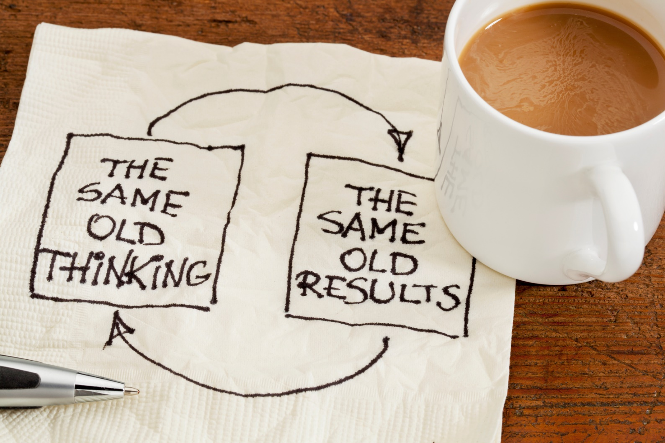
Hold Your Thinking- Tape into p. 9

Slide 22
HOLD YOUR THINKING WITH “ELEVEN”
Turn to page 36 in your textbook
We are going to do “Hold Your Thinking” (in your notebook page 9) while we read

Slide 23
Hold Your Thinking Post-It Lot
Character Names One Memorable Part
Two Sentence Summary Connections

Slide 24
Art Project
Everyone gets a big poster
I want you to design a sweater that reflects your identity
On the back of your poster, you must have a 5 sentence “artist statement” that explains how the sweater reflects YOU.
Prepare to Present xoxo

Slide 25
“Eleven”
What is a narrative?

Slide 26
“Eleven”
What is a narrative?
A narrative can be nonfiction or fiction
It is when the story is told in first person point of view

Slide 27
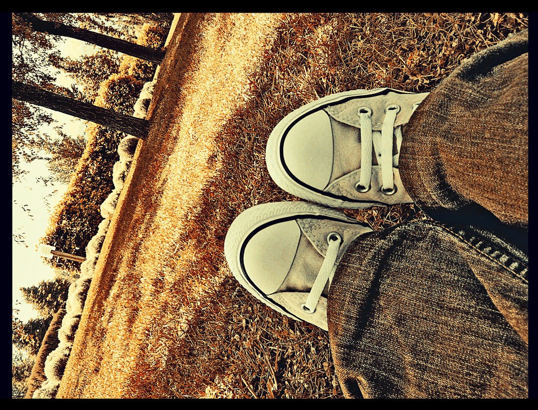
Flocabulary POV

Slide 28
“Eleven” Diary Entry
Write a diary entry as if you are Rachel from the short story “Eleven.” You are writing the day after her birthday and the events that took place in the story. What might she say? How is she feeling today? What might she tell her diary?

