Slide 1
Week 1 – Social Studies
6th Grade

Slide 2
Seating Chart Period 6 & Grab a packet (back table)
Teacher Desk Board Door
Dejuan & Miles Allyson & Victor
Laura & Michael Amanda & Beau Chris & Curtis Kelsey H. & Briar
Brook & Silas Giacomo & Jacobi
Grayson & Maxwell Noah & Isabella
Montrease & Mishawn
Triniti & ZaCorriun & Parker

Slide 3
Bellringer
What do you know about your family history?
Ms. Kate’s – Irish & Scottish Warriors (explains a lot)

Slide 4
On your bellringer you will have to select a role
At the end of the week you will reflect on how everything went
Remember, you CANT control how others act, BUT you CAN control how you act toward them.

Slide 5
Group Roles
6th Grade

Slide 6
Classroom Leaders
Calendar Keeper (make sure the correct date is written on the board)
DJ (can create a clean weekly play list for us to listen to)
Electrician (turns lights on and off)
Teachers’ assistants (pass out materials & pick them up & run errands)
Liveschool point taker
Botanist (makes sure Ms. Kate doesn’t kill her cactus)
Team-Point Taker

Slide 7
Group Roles
Leader (makes sure everyone has what they need to complete the task)
Artist (creates visual representations of group’s work)
Librarian (looks up unknown words)
Reporter (asks the questions and helps the leader with presentations)

Slide 8
1st PERIOD RA: 8:55am – 10:10am
2nd PERIOD: 10:10am – 11:07am
Locker Break: 11:07am-11:12am
PA: 11:12am –11:32am
Lunch: 11:32am – 12:02pm
PLT: 12:05pm-12:50pm
Lockers: 12:50pm-12:55
4th PERIOD: 12:55pm – 1:52pm
5th PERIOD: 1:55pm - 2:52pm
6th PERIOD: 2:57pm - 3:55pm

Slide 9
Turn to page 2 of packet
Get ready for guided notes on expectations
Don’t worry, you eventually get to create some for us.

Slide 10
How Class Works
1.) Get your materials (you will have a class folder and an interactive notebook)
2.) Quietly work on your warm up at the start of every class
3.) Listen quietly to instruction
4.) Practice skills with group/partner work
5.) Independently work on an exit ticket (silent)

Slide 11
Expectations for each activity
3 Different Types:
INDEPENDENT
PARTNER/GROUP
BIG GROUP
HALLWAY

Slide 12
INDEPENDENT EXPECTATIONS
COME TO CLASS ON TIME
DO NOT EAT/DRINK WITHOUT PERMISSION
HAVE A PENCIL, YOUR CLASS FOLDER, AND HOMEWORK FOLDER ON YOUR DESK
QUIETLY BEGIN WEEKLY BELLRINGER (5 MINUTES)
MAINTAIN A SILENT WORKING ENVIROMENT

Slide 13
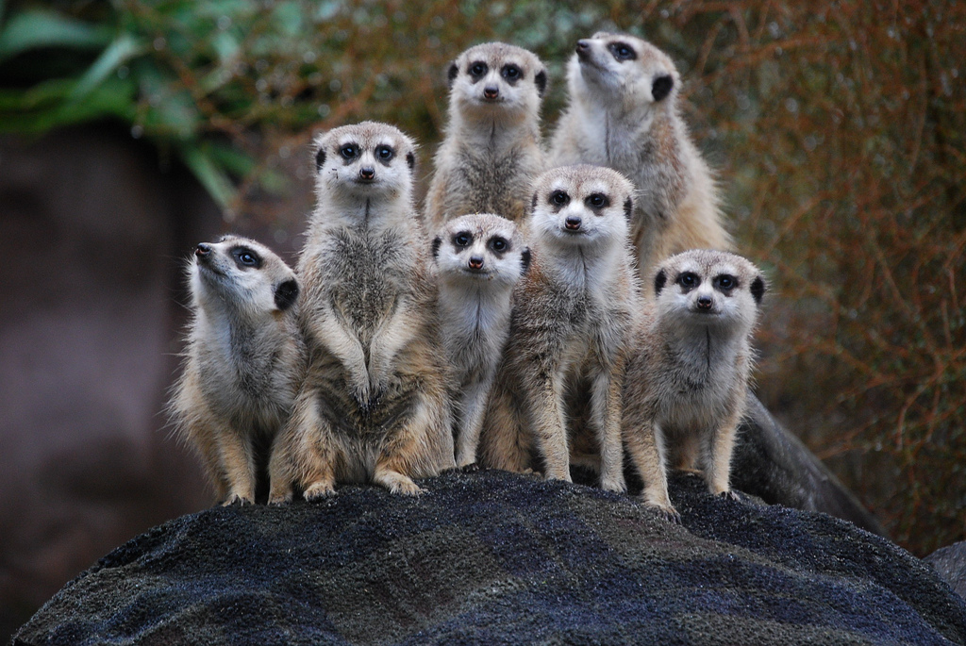
PARTNER/SMALL GROUP EXPECTATIONS
DO NOT TALK TO OTHER GROUPS
ELECTRONICS ARE OFF AND AWAY
(UNLESS YOU HAVE PERMISSION)
FULFILL PARTNER/GROUP ROLES
REMAIN SEATED AT ALL TIMES
BE KIND

Slide 14
BIG GROUP EXPECTATIONS
LISTEN QUIETLY TO OTHERS
ELECTRONICS OFF AND AWAY
FOR YOUR TURN, ALWAYS RAISE YOUR HAND AND WAIT
ONLY ONE PERSON TALKS AT A TIME
STAY SEATED WHILE SOMEONE IS SHARING

Slide 15
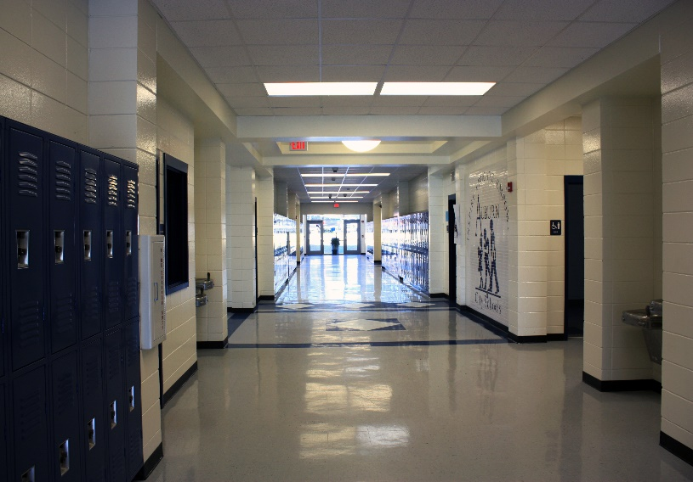
HALLWAY EXPECTATIONS
KEEP HANDS AND FEET TO YOURSELF
COME TO CLASS ON TIME
REMAIN QUIET WHILE CLASSES ARE IN SESSION
ONLY ONE PERSON CAN LEAVE THE ROOM AT A TIME
PLEASE KEEP THE BATHROOMS AS NEAT AS YOU FIND THEM
IN THE EVENT OF AN EMERGENCY, FIND THE CLOSEST TEACHER FOR ASSISTANCE

Slide 16
BREAKING EXPECTATION
1. CHANGE OF SEAT (1ST WARNING)
2. LOSS OF PRIVILEDGE

Slide 17
FOLLOWING EXPECTATIONS
1. LiveSchool Points get you cool privileges
2. Partners/Teams with the most group points can sit in the Library Lounge for a week.

Slide 18
Safety Expectations – Big DEAL
Fire Drill we leave through the side door
Lock Down – we hide around the room (not all in one place because that is stupid), barricade the door, and shhhhhh
Tornado – we hide where there are no windows. Cover your head!
Medical Emergency – one person runs to office, another to Mr. Wall’s (getting first responders)

Slide 19
Expectations for the Teacher
Create a list of expectations that you have for Ms. Kate and Ms. G. What can we do to ensure your engagement and success in this class?

Slide 20
SURVEY TIME
Want to know a bit more about you and what parts of history fascinate you ☺

Slide 21
Homework
PASS OUT BACK TO SCHOOL LETTERS
READ THROUGH AND ASSIGN HOMEWORK
THESE GO IN YOUR HOMEWORK FOLDERS PEOPLE

Slide 22
BELLRINGER
What is a symbol
Draw a picture that symbolizes YOU

Slide 23
TIME CAPSULE TIME
IN YOUR PACKET.
Starting with “TOP TEN FAVORITES”
History is all about understanding special moments in time. This is one of those times. We are going to revisit this moment in May 2020 to see how much you have changed! Create a time capsule.
TRACE YOUR HAND
CREATE PERSONAL AND ACADEMIC GOALS
DESCRIBING THE FIRST DAY FEELINGS

Slide 24
BELLRINGER
What is a time-capsule? Why did we make one?

Slide 25
Create your own country

Slide 26
BELLRINGER
What does the word “origin” mean?

Slide 28
Classroom Leaders: DJs: Silas, Brook, Parker, Dejuan Electricians Isabella Teachers Assistants: Amanda, Mishawn Liveschool Point-taker: CJ, Grayson, Maxwell, Laura Botanist: Knox, Giacamo Team Point-Taker: Kelsey, Amanda

Slide 29
Archeology Article w/ Active Reading Strategies (on last page)

Slide 30
BELLRINGER
What do you know about archeology and anthropology?

Slide 31
Pretest on Human Origins ☺

