Slide 1
Week 1 – Language Arts
6th Grade

Slide 2
Bellringer
Write two truths and one lie
Ms. Kate’s
- I speak French
- I like surfing
- I am terrified of Iguanas

Slide 3
On your bellringer you will have to select a role
At the end of the week you will reflect on how everything went
Remember, you CANT control how others act, BUT you CAN control how you act toward them.

Slide 4
Group Roles
6th Grade

Slide 5
Classroom Leaders 2nd
Calendar Keeper (make sure the correct date is written on the board) Angel
DJ (can create a clean weekly play list for us to listen to by tomorrow)
Montrease, Brook, Summer, Corey
Electrician (turns lights on and off) Julian & Destiny
Teachers’ assistants (pass out materials & pick them up & run errands) Zoe, Triniti, Morgan, Isabella
Liveschool point taker Maddy, Morgan, Maxwell
Botanist (makes sure Ms. Kate doesn’t kill her cactus) Knox, Eayn
Team-Point Taker Alon, Duke

Slide 6
Group Roles
Leader (makes sure everyone has what they need to complete the task)
Artist (creates visual representations of group’s work)
Librarian (looks up unknown words)
Reporter (asks the questions and helps the leader with presentations)

Slide 7
1st PERIOD RA: 8:55am – 10:10am
2nd PERIOD: 10:10am – 11:07am
Locker Break: 11:07am-11:12am
PA: 11:12am –11:32am
Lunch: 11:32am – 12:02pm
PLT: 12:05pm-12:50pm
Lockers: 12:50pm-12:55
4th PERIOD: 12:55pm – 1:52pm
5th PERIOD: 1:55pm - 2:52pm
6th PERIOD: 2:57pm - 3:55pm

Slide 8
Turn to page 2 of packet
Get ready for guided notes on expectations
Don’t worry, you eventually get to create some for us.

Slide 9
How Class Works
1.) Get your materials (you will have a class folder and an interactive notebook)
2.) Quietly work on your warm up at the start of every class
3.) Listen quietly to instruction
4.) Practice skills with group/partner work
5.) Independently work on an exit ticket (silent)

Slide 10
Expectations for each activity
3 Different Types:
INDEPENDENT
PARTNER/GROUP
BIG GROUP
HALLWAY

Slide 11
INDEPENDENT EXPECTATIONS
COME TO CLASS ON TIME
DO NOT EAT/DRINK WITHOUT PERMISSION
HAVE A PENCIL, YOUR CLASS FOLDER, AND HOMEWORK FOLDER ON YOUR DESK
QUIETLY BEGIN WEEKLY BELLRINGER (5 MINUTES)
MAINTAIN A SILENT WORKING ENVIROMENT

Slide 12
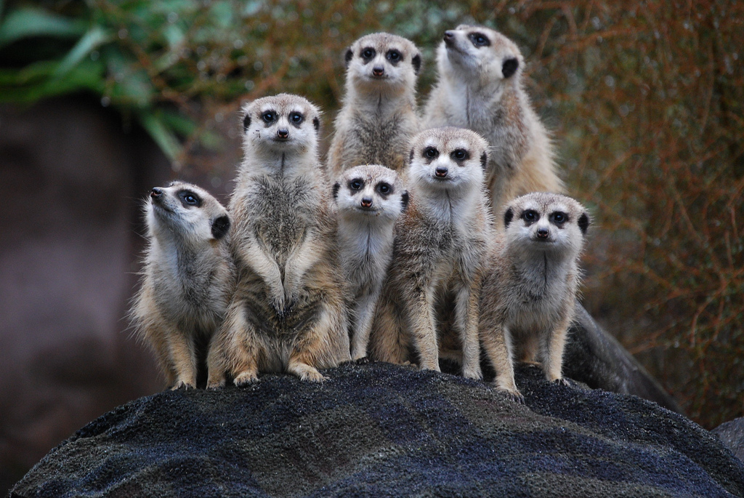
PARTNER/SMALL GROUP EXPECTATIONS
DO NOT TALK TO OTHER GROUPS
ELECTRONICS ARE OFF AND AWAY
(UNLESS YOU HAVE PERMISSION)
FULFILL PARTNER/GROUP ROLES
REMAIN SEATED AT ALL TIMES
BE KIND

Slide 13
BIG GROUP EXPECTATIONS
LISTEN QUIETLY TO OTHERS
ELECTRONICS OFF AND AWAY
FOR YOUR TURN, ALWAYS RAISE YOUR HAND AND WAIT
ONLY ONE PERSON TALKS AT A TIME
STAY SEATED WHILE SOMEONE IS SHARING

Slide 14
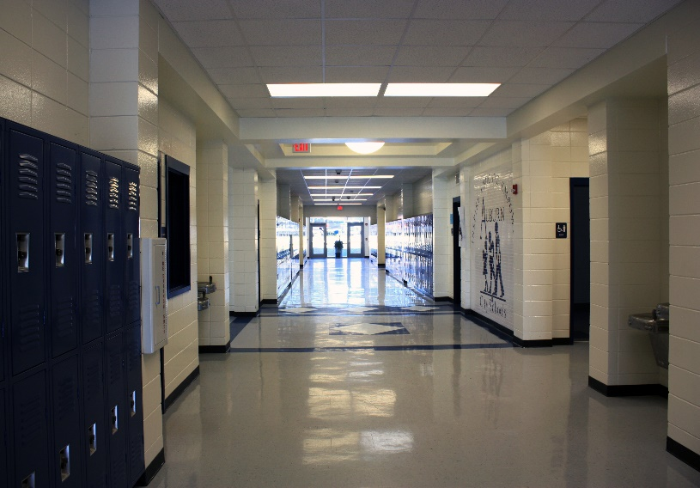
HALLWAY EXPECTATIONS
KEEP HANDS AND FEET TO YOURSELF
COME TO CLASS ON TIME
REMAIN QUIET WHILE CLASSES ARE IN SESSION
ONLY ONE PERSON CAN LEAVE THE ROOM AT A TIME
PLEASE KEEP THE BATHROOMS AS NEAT AS YOU FIND THEM
IN THE EVENT OF AN EMERGENCY, FIND THE CLOSEST TEACHER FOR ASSISTANCE

Slide 15
BREAKING EXPECTATION
1. CHANGE OF SEAT (1ST WARNING)
2. LOSS OF PRIVILEDGE

Slide 16
FOLLOWING EXPECTATIONS
1. LiveSchool Points get you cool privileges
2. Partners/Teams with the most group points can sit in the Library Lounge for a week.

Slide 17
Safety Expectations – Big DEAL
Fire Drill we leave through the side door
Lock Down – we hide around the room (not all in one place because that is stupid), barricade the door, and shhhhhh
Tornado – we hide where there are no windows. Cover your head!
Medical Emergency – one person runs to office, another to Mr. Wall’s (getting first responders)

Slide 18
Expectations for the Teacher
Create a list of expectations that you have for Ms. Kate and Ms. G. What can we do to ensure your engagement and success in this class?

Slide 19
SURVEY TIME
HELP US PICK OUT BOOKS YOU DON’T HATE

Slide 20
Homework
PASS OUT BACK TO SCHOOL LETTERS
READ THROUGH AND ASSIGN HOMEWORK
THESE GO IN YOUR HOMEWORK FOLDERS PEOPLE

Slide 21
BELLRINGER
What does the word “genre” mean to you?
Example?

Slide 22
SILENT EXCHANGE CHALLENGE
FOLLOW DIRECTIONS!
MY 3 BEST NONVERBAL COMMUNICATORS GET TO SIT IN THE LIBRARY LOUNGE FOR THE REST OF THE WEEK!!!!!!

Slide 23
SILENT EXCHANGE REFLECTION
BOTTOM OF THE PAGE
What was it like to communicate without words? What communication strategies did you use instead of language?

Slide 24
BELLRINGER
What is an open-ended question?

Slide 25
Journalism 101

Slide 26
Watch the Katie Couric Clip and record 5 techniques for a good interview!
https://m.youtube.com/watch?v=4eOynrI2eTM

Slide 27
Use the 5 techniques for a good interview!

Slide 28
“What If…” Questions
Hypothetical questions help you learn more about another person’s personality, as well as their ideal state of the world. Since many of these questions might evoke longer responses, they are better suited for one-on-one conversations or smaller group discussions.
If you could throw any kind of party, what would it be like and what would it be for?
If you could paint a picture of any scenery you’ve seen before, what would you paint?
If you could choose to stay a certain age forever, what age would it be?
If you knew the world was ending in 2012, what would you do differently?
If you could choose anyone, who would you pick as your mentor?
If you could witness any event past, present or future, what would it be?
If you could learn to do anything, what would it be?
If you had to work on only one project for the next year, what would it be?
If you were immortal for a day, what would you do?

Slide 29
BELLRINGER
Why do we interview others? What can you do to make the interview great?

Slide 30
Classroom Leaders: DJs: Will, Briar, Ellis, Lukas, Chris, Spencer Electricians Ellis, Neviah, Spencer, Za’Corriun Teachers Assistants: Kaliyah Mishawn Liveschool Point-taker: Brayden, Jae’Suan Botanist: Ellis Neviah Team Point-Taker: Will & Laura & ZaCorriun, CJ

Slide 31
Classroom Leaders: DJs: Braylin, Drew, Charlotte, Preston, Vivienne, Rachel, Stellla,, Silas, Isaiah, Charley, Kelsey Electricians: Aida, Satchel Teachers Assistants: Amanda, Vivienne, Avery, Charley, Hudson Liveschool Point-taker: Madeline, Seamus, Kate, Isaiah, Josh Botanist: Sophie, Team Point-Taker: Lyla

Slide 32
Breaking News!
Read your partner’s interview answers and tell the story of your interview
Who is this person and what did you learn about her/him?

Slide 33
BELLRINGER
List one cool thing you learned this week

Slide 34
Fun Friday
4th Period: 12:55 – 1:40
5th Period: 1:43 – 2:28
6th Period: - 2:33 – 3:18
West Is Best (Auditorium): 3:25 – 3:35
Fun Friday (Football Field): 3:35 – 3:55

